Slide 1

Group 2
REPORT

Slide 2
Guide
git clone https://github.com/kite3412/Group2
conda env create -f environment.yml
conda activate group2
pip install -r requirement.txt
python data_ingestion.py
cd olist_project
dbt deps
dbt run
dbt test
olist_data_analysis.ipynb (kernel: group2)

Slide 3
Table of Contents
1 Introduction
Overview
2 Technology Stack
- Why DuckDB
- Why DBT
- Why Python
3 Data Engineering Pipeline (ELT)
- Dataset: Brazilian e-commerce
- Extract : Data Ingestion
- Load : Storing in DuckDB
- Transform : Expectations
4 Data Ingestion
5 Data Warehouse
- Star Schema Design
6 Data Validation
- dbt-utils and validation
dbt-expectations
7 Data Visualization and Analysis
8 Challenges & Solutions
9 Conclusion
10 References

Slide 4
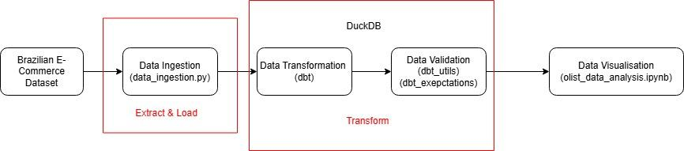
Overview
This project transforms the Brazilian E-Commerce Dataset into star schema which can be used for business intelligence analysis. An ELT process is used in which the data is extracted and loaded into DuckDB, and transformed in DuckDB using dbt. The transform data is then tested using dbt_utils and dbt_expectations and finally is used for visualisation using python(pandas, matplotlib and seaborn).

Slide 5

Why DuckDB?
DuckDB is chosen as it is free, runs on local machine without heavy configuration, supports dbt, is designed for fast analytical queries, supports SQL standards and integrates well with python.
BigQuery is considered but not chosen as it is not free, runs on cloud which becomes unavailable when the internet is down and needs more configuration when comparing to DuckDB.

Slide 6

Why dbt?
dbt simplifies ELT pipelines by enabling modular SQL deployment, version control and build-in testing. It supports transforming of raw data into fact and dimension tables.
Spark is considered but not chosen because Spark does not transform data inside data warehouse and it requires separate Spark clusters which can be expensive.

Slide 7

Why Python?
Python is chosen for it rich ecosystem for data manipulation(pandas) and data visualisation(matplotlib and seaborn). This combination allows for rapid exploratory data analysis and creation of insightful charts.
Tableau and Power BI are considered but not chosen because it is not free.

Slide 8
Benefits of a Local Pipeline over Cloud Solutions
Data Security and Control: Sensitive data remains on-premise and allows full control over data access, backup, and compliance policies
Simplified Setup: With DuckDB, DBT, and Great Expectations running locally, this setup is straightforward and can be managed with minimal infrastructure overhead
Performance for Medium-Sized Data: For medium-sized data, local processing can be more efficient than transferring data to and from cloud platforms because it avoids network latency delays, leading to faster query performance

Slide 9
Data Ingestion
The Brazilian E-Commerce Dataset is downloaded from kaggle and is stored in the OLIST folder. The data_ingestion.py will read all csv files inside the folder and create a DuckDB database file with tables with the same names as the csv files.
This step makes the “Extract” and “Load” stages of our ELT pipeline:
Extract: Reading data from CSV files.
Load: Ingesting the data into the DuckDB for transformation.

Slide 10
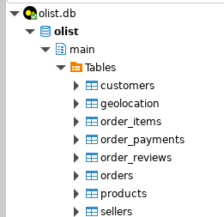
Data Ingestion
Output:

Slide 11
Data Warehouse
A star schema is used for the transformed data.
Why star schema?
Query Efficiency: The star schema is optimised for analytical queries. Star schema structure of one fact table with multiple dimension tables minimise the the number of joins required and simplifies aggregation.
Flexibility: Dimension tables can be extended or enriched over time without altering the fact table.
Performance: Analytical database such as DuckDB can quickly scan and aggregate data in a star schema.

Slide 12
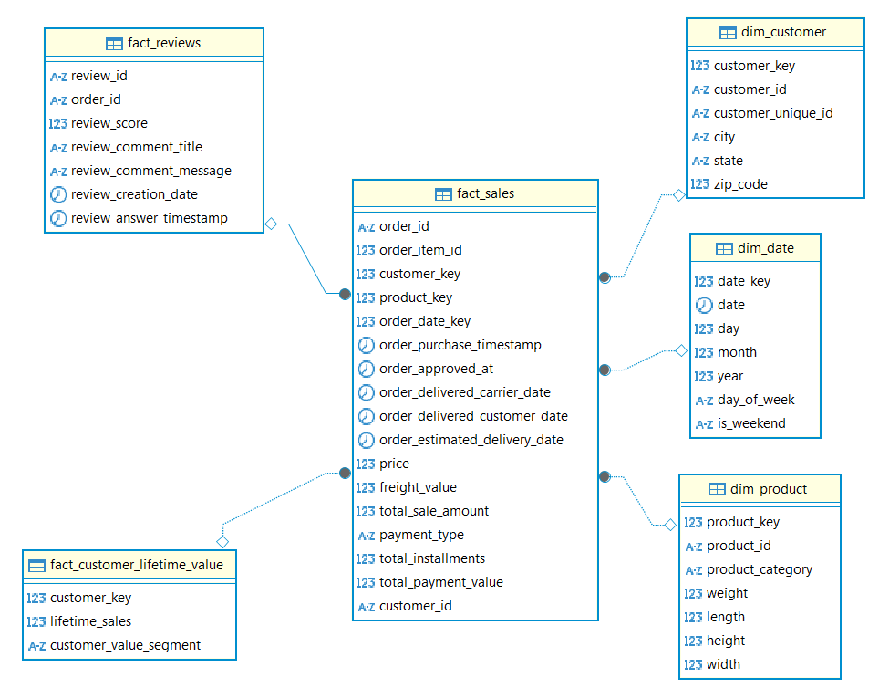
Data Warehouse Design

Slide 13
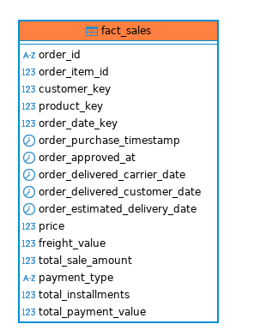
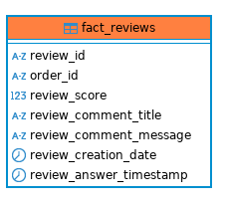
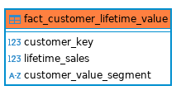
Data Warehouse
Fact tables: fact_sales, fact_reviews, fact_customer_lifetime_value

Slide 14
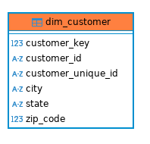
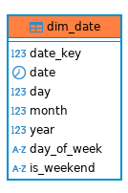
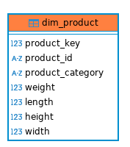
Data Warehouse
Dimension tables: dim_customer, dim_date, dim_product

Slide 15
fact_sales.sql
Data Transformation
Centralizes detailed transactional data for each order item.
Serves as the primary fact table in a star schema for reporting and analytics.
Computations:
Total Sale Amount: as price + freight_value
Payment Aggregation: Sums installments and payment values per order.
Ensures consistency by handling NULLs and trimming inputs.
Integration with Dimensions
DimCustomer: Joins on customer_id to link customer details.
DimProduct: Joins on product_id for product specifics.
DimDate: Uses order_purchase_timestamp to generate a date key for time-based analysis.

Slide 16
Data Transformation
Fact_reviews.sql
Captures customer feedback for individual orders.
Combines quantitative (review score) and qualitative (review comments) data.
Each row represents a single customer review.
Links the review to its corresponding order.
Fact_customer_lifetime_value.sql
Aggregates sales data at the customer level.
Enables customer segmentation based on lifetime sales performance.
Calculations:
Lifetime Sales: as the sum of total_sale_amount for each customer.
Customer Value Segment: Uses a CASE statement to classify customers:
Low: lifetime_sales < 100
Medium: lifetime_sales between 100 and 500
High: lifetime_sales > 500

Slide 17
Data Transformation: Dimension tables
dim_customer.sql
Acts as the central customer dimension used for slicing and dicing sales and order data
Enables targeted segmentation and location-based analysis using clean geographic attributes
Key Components & Transformations
Surrogate Key (customer_key): sequential identifier to facilitate efficient joins with fact tables without relying on the business keys
Business Keys:
customer_id: Original customer identifier
customer_unique_id: Ensures each customer is distinctly recognized
dim_product.sql
Acts as the product dimension providing detailed attributes for analysis
Enables detailed product-level analysis and segmentation
Supports performance tracking and reporting across different product categories and sizes
Filters out records with NULL product_category_name, ensuring valid category data

Slide 18
Data Transformation
Dim_date.sql
Serves as the time dimension, enabling detailed time-based analysis across fact tables.
Facilitates trend analysis, seasonality studies, and performance tracking over time.
Key Attributes & Transformations
Date Key (surrogate key): Derived by converting the date into a YYYYMMDD integer format.
Raw Date:The actual date value for each record.
Day, Month, Year: Extracted using STRFTIME to break down the date into its constituent parts.
Day of Week: Calculated to represent the day as a number (0 = Sunday, 6 = Saturday).
Weekend Flag: Uses a CASE statement to mark dates as 'Y' if they fall on a weekend, otherwise 'N'.

Slide 19
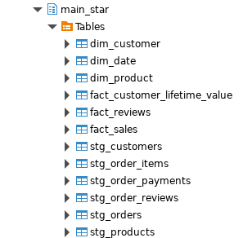
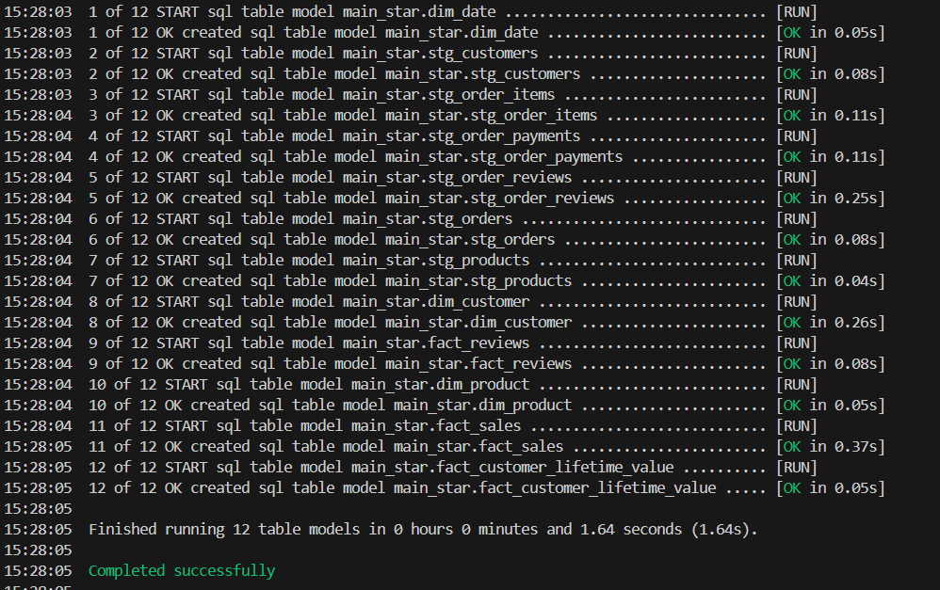
Data Transformation
Output:

Slide 20
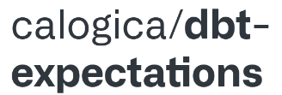
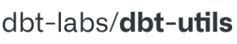
Data Validation
For data validation, dbt_utils and dbt_expectations are used because both packages are integrated with dbt so we do not need to install external libraries such as Great Expectations. With the two packages, data validation is made simple as we do not need to write SQL codes to carry out data validation. Moreover, the two packages offer a comprehensive list of data tests.

Slide 21

Data Validation
Generic Test
A generic test is carried out on all the columns used for data visualisation to ensure there is no null value.

Slide 22
Data Validation
Test 1
Carry out tests on the order purchase timestamp and total sale amount columns of the sales fact table as data from both columns is used to plot the monthly sales trend of the top 10 product category. For the order purchase timestamp column, the test ensures all the data is of the type timestamp. For the total sale amount columns, the test ensures all the data is more than zero.

Slide 23
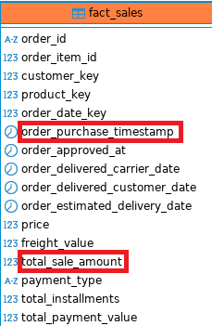
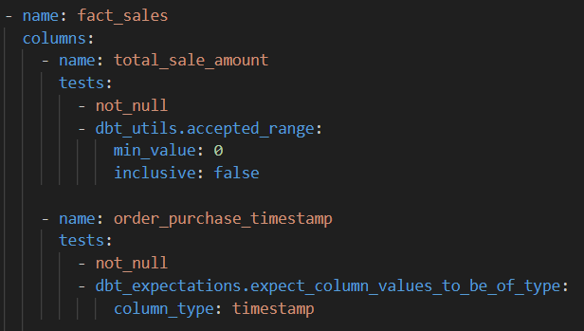
Data Validation
Test 1

Slide 24
Data Validation
Test 2
Carry out tests on the freight value column of the sales fact table as data from the column is used to plot the average freight cost by customer state. For the freight value column, the test ensures all the data is equal to or more than zero.

Slide 25
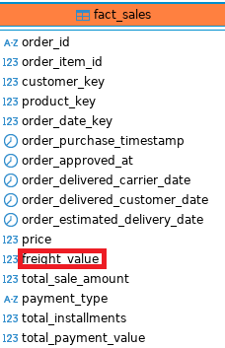
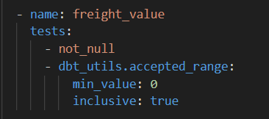
Data Validation
Test 2

Slide 26
Data Validation
Test 3
Carry out tests on the review score column of the reviews fact table as data from the column is used to plot the distribution of review scores by top 10 product category. For the review score column, the test ensures all the data is within 1 to 5 inclusive.

Slide 27
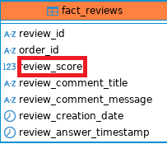
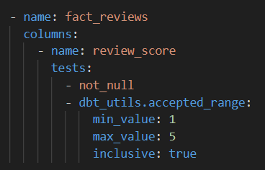
Data Validation
Test 3

Slide 28
Data Validation
Test 4
Carry out tests on the payment type column of the sales fact table as data from the column is used to plot the average order by payment type. For the payment type column, the test ensures all the data is one of the four payment type which are boleto, credit card, debit card and voucher.

Slide 29
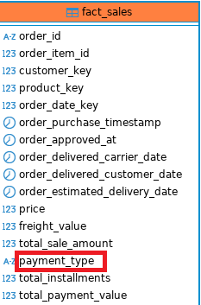
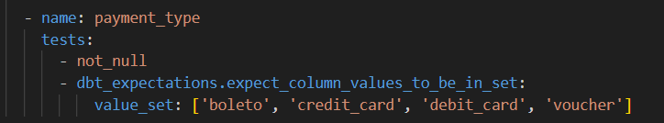
Data Validation
Test 4

Slide 30
Data Validation
Test 5
Carry out tests on the order delivered customer date column of the sales fact table as data from the column is used to plot the distribution of shipping time. For the order delivered customer date column, the test ensures all the data is of the type timestamp.

Slide 31
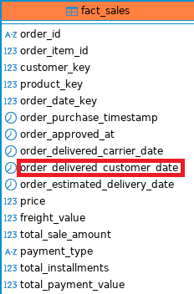
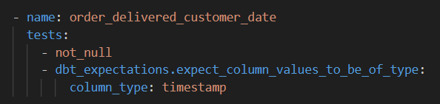
Data Validation
Test 5

Slide 32
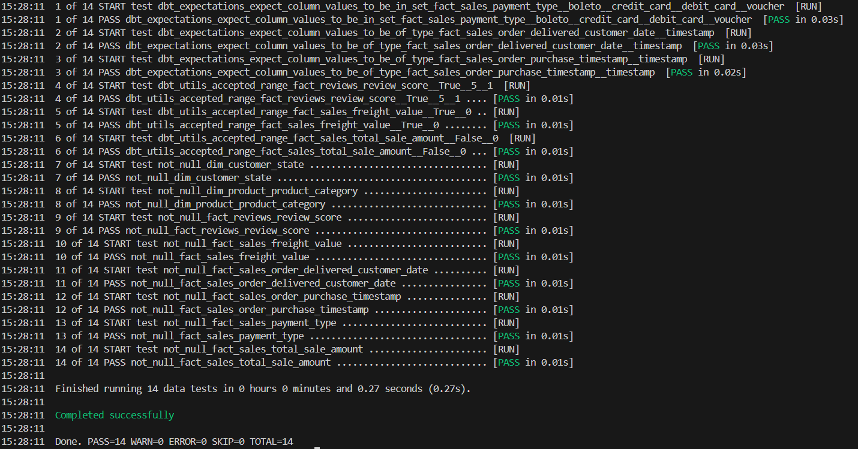
Data Validation
Output

Slide 33

Data Visualisation
A jupyter notebook: olist_data_analysis.ipynb is created to visualise data from the star schema in DuckDB with the help of pandas, matplotlib and seaborn. Data from the star schema is ingested into pandas dataframe using sqlalchemy.

Slide 34
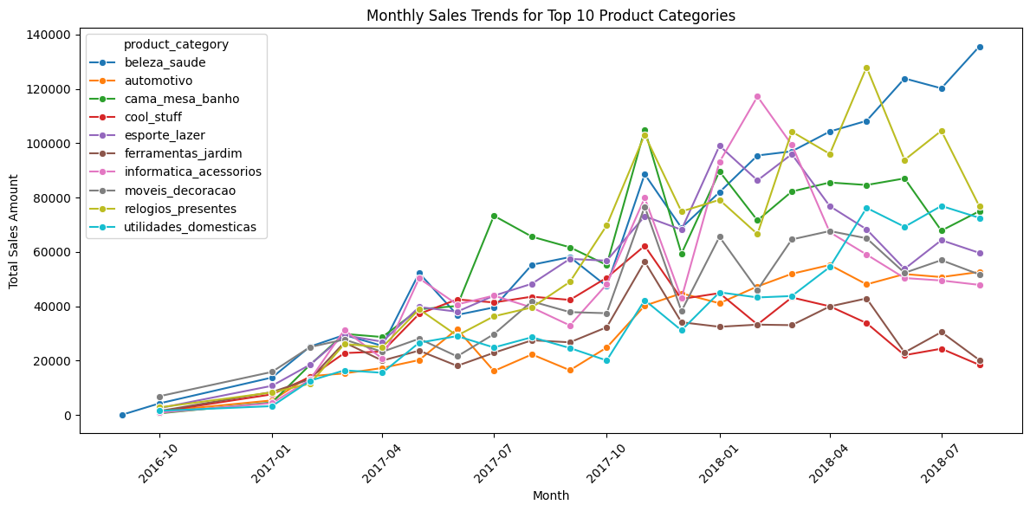
Data Visualisation
This visualisation reveals seasonality and category-specific trends, which are crucial for forecasting and inventory management.

Slide 35
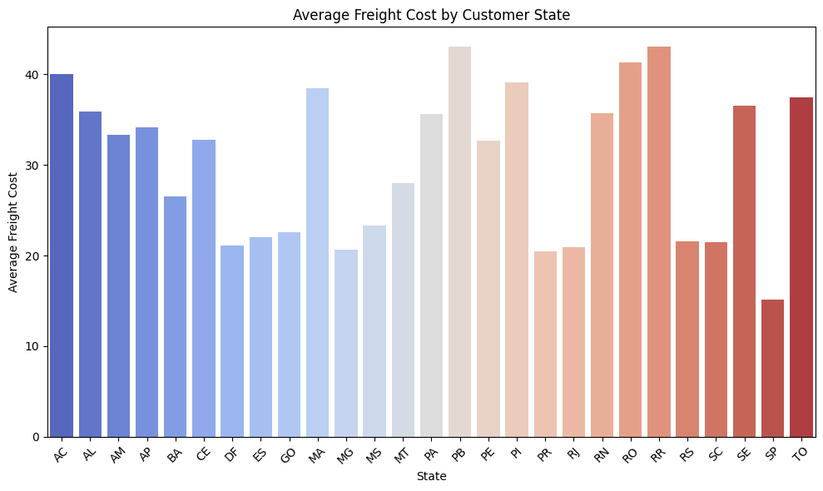
Data Visualisation
This visualisation identifies regions where shipping costs are higher, guiding logistics optimization and potential pricing strategy adjustments.

Slide 36
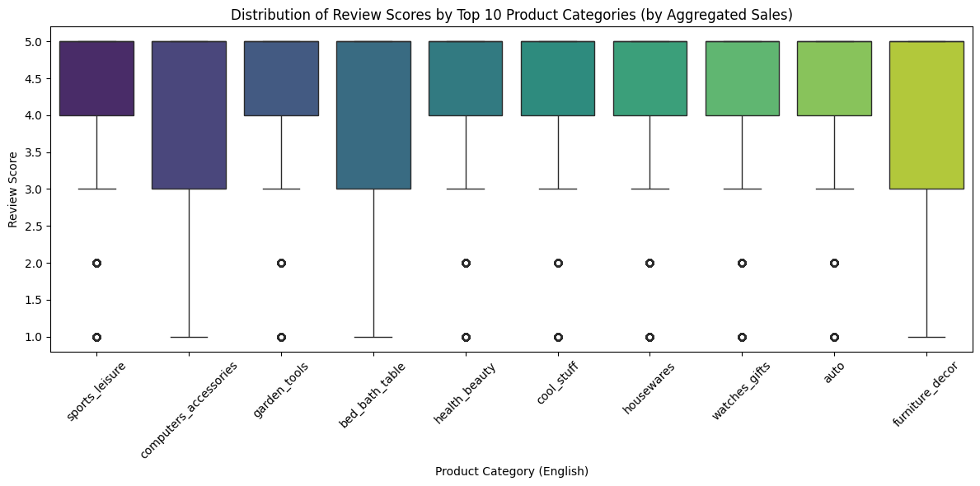
Data Visualisation
This visualisation highlights product quality and customer satisfaction variances, helping prioritize improvements or promotional efforts.

Slide 37
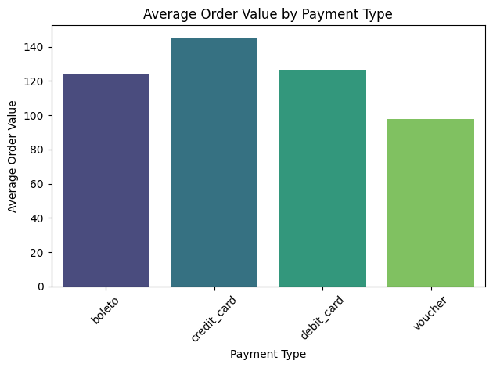
Data Visualisation
This visualisation provides insights into customer behavior based on payment preferences, which can inform marketing and discount strategies.

Slide 38
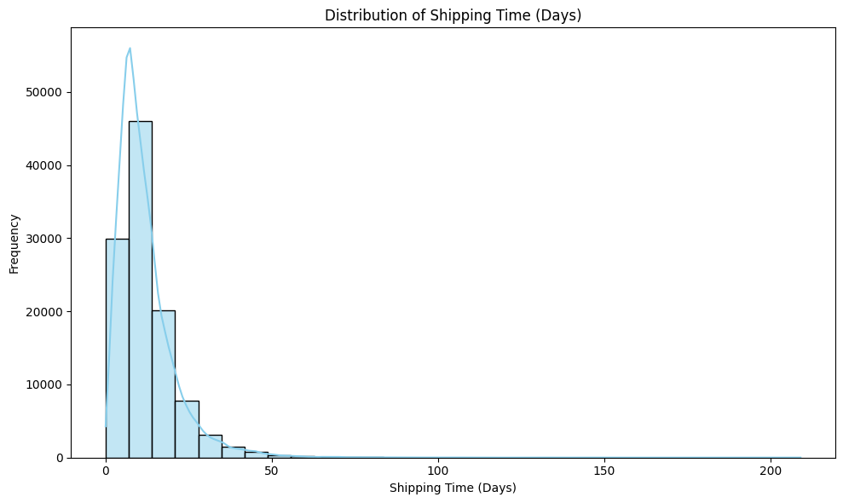
Data Visualisation
This visualisation displays the distribution of shipping times, helping identify outliers and opportunities to improve delivery performance.

Slide 39
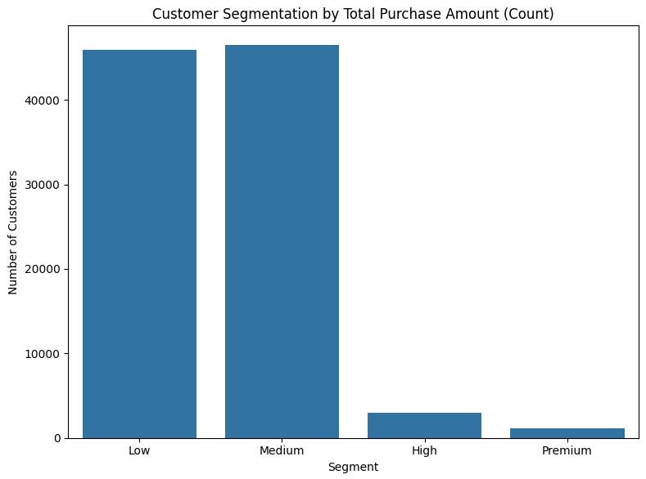
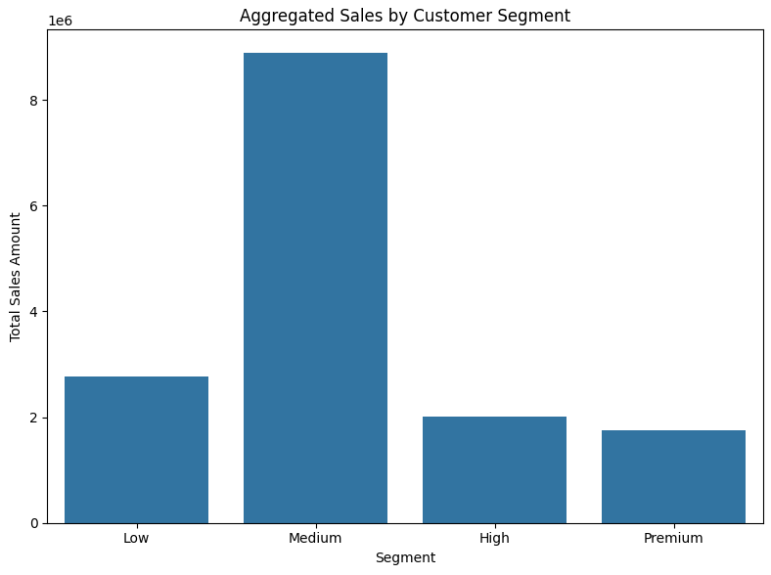
Data Visualisation
“Low Segment” has similar number of customers as ‘Median Segment”, but in terms of total sales, it’s much less important.
The two higher segments “High” and “Premium”, despite having much fewer customers, their combined sales are higher than the ‘Low” segment.
A recommendation is to keep focusing on the “Medium” segment because it’s clearly the most important in terms of aggregated sales, and try to increase reach to the “high” and “premium” to increase the number of customers from those segments, as they are more promising than the “Low” segment.

Slide 40
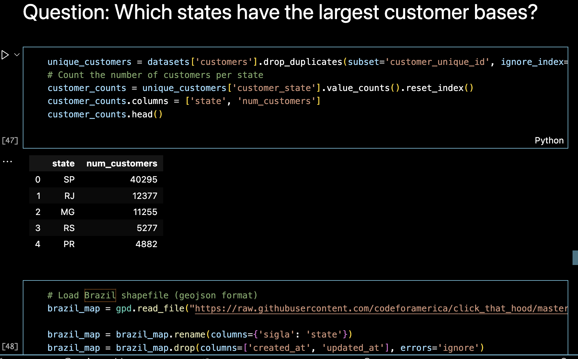
Data Visualisation

Slide 41
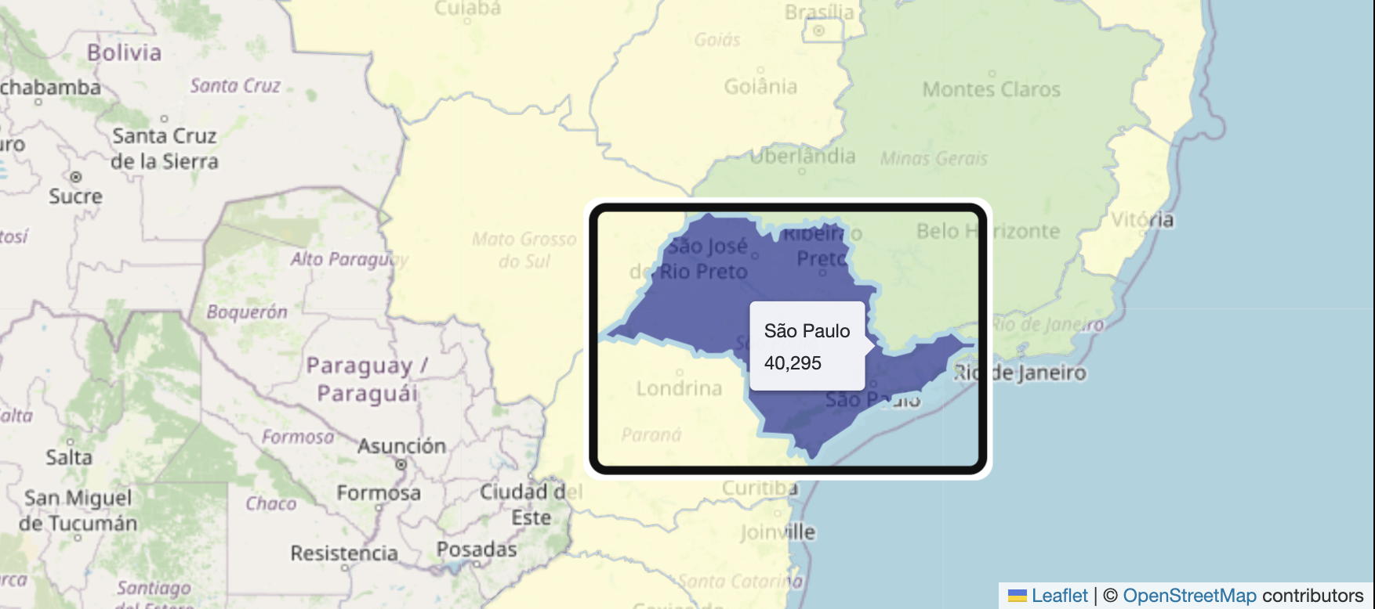
Data Visualisation
If we look at the map, we can see that Sao Paulo has the highest number of customers, with 40,295. It is followed by Rio de Janeiro with 12,377 customers and Minas Geraise with 11,255 customers.

Slide 42
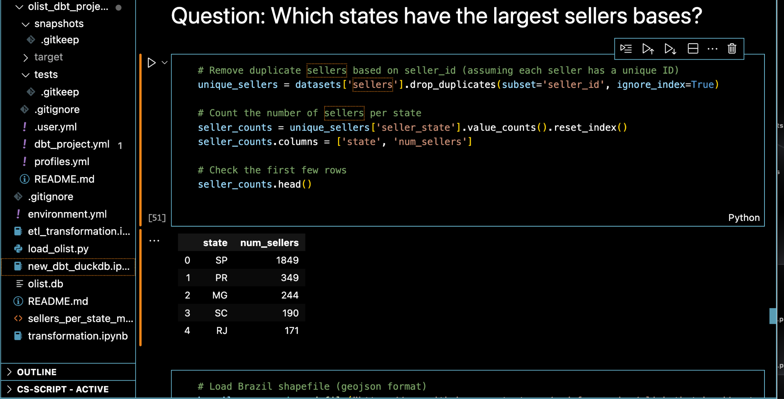
Data Visualisation

Slide 43
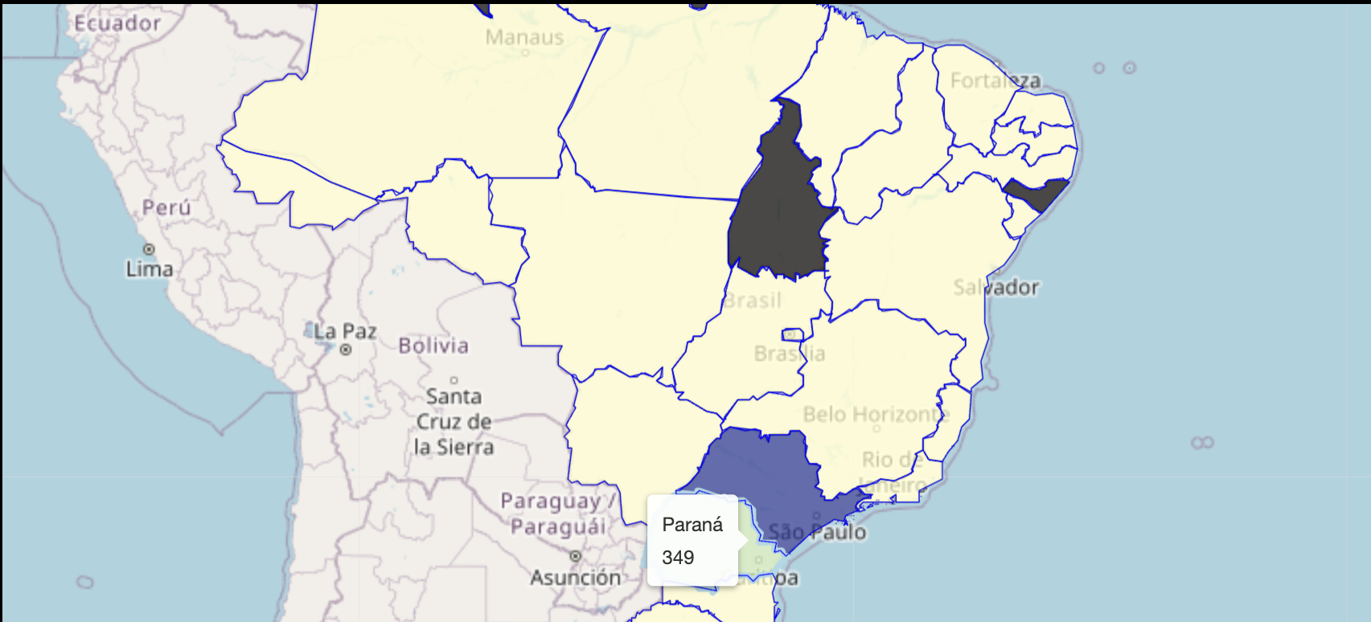
Data Visualisation
If we make comparison, we can see that Sao Paulo has the highest number of sellers, with 1,849. It is followed by Parana with 349 and Minas Geraise with 244 sellers. Rio de Janeiro is now the 4th largest sellers base.

Slide 44
Business insights
Analysis of monthly sales by product category revealed clear seasonal trends and identified categories driving revenue growth.
The average freight cost analysis showed that certain regions incur higher shipping expenses, suggesting the need for logistics optimization.
Review score distributions vary significantly across product categories, providing actionable insights into product quality.
Different payment types correlate with varying average order values, indicating distinct customer segments.
Shipping time analysis pinpointed potential delays, guiding operational improvements to enhance customer satisfaction.

Slide 45
Business insights
6. Logistics Optimization – If customers are concentrated in certain states but sellers are far from them, optimizing fulfillment centers and partnerships can reduce delivery times and costs.
7. Expansion Opportunities – If certain states have fewer sellers but high demand, e-commerce platforms can attract new vendors to improve supply.

Slide 46
Conclusions
This project analyzed the Brazilian e-commerce dataset, focusing on data engineering processes to extract, transform, and analyze customer and seller distribution. By leveraging dbt and DuckDB, we efficiently structured the data and generated insights that can drive business decisions in the e-commerce industry.

Slide 47
References:
https://www.kaggle.com/datasets/olistbr/brazilian-ecommerce/code
DuckDB documentation https://duckdb.org/docs/stable/
Dbt documentation https://docs.getdbt.com/docs/build/documentation

